Slide 1
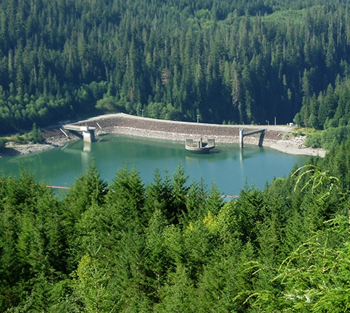
The Journey of Hydropower in Snohomish County
Notes:
Today I’m here to teach you about The Journey of Hydropower.

Slide 2
Learning Targets
I can put the parts of a complete hydropower system in order, to show how moving water is used to generate electricity.
I can explain the difference between renewable and non-renewable energy resources.
I can compare hydropower with other energy resources in Snohomish County and across the United States.

Slide 3
Hydroelectric
Hydro = water
Hydroelectric = electricity generated from the motion of water
Notes:
Hydro means water and Hydroelectric means electricity generated from the motion or movement of water. Some people say hydropower. Hydropower and hydroelectric mean the same thing. We’re going to investigate how all the parts of this system work together to bring us the electricity that we use all day, every day.

Slide 4
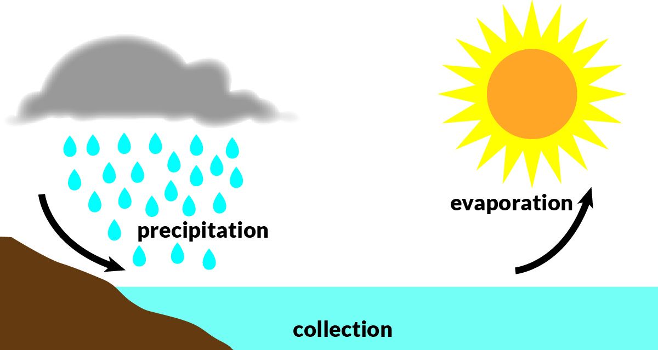
Hydropower is RENEWABLE
Renewable: means that you can harness something from the Earth that never gets used up or taken away.
Notes:
Energy sources can be classified as renewable and nonrenewable.
Hydropower is a renewable energy source. Renewable means that you can harness something from the earth that never gets used up and can be used over and over again. The water needed for this hydropower system can be used again and again thanks to the water cycle.

Slide 5
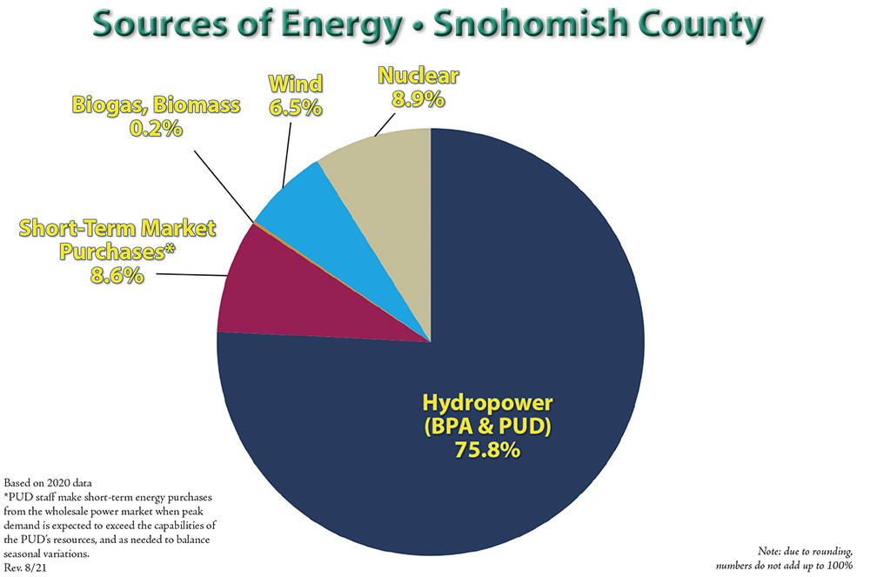
Notes:
Does Snohomish County PUD get most of its electricity from renewable or non-renewable resources?

Slide 6
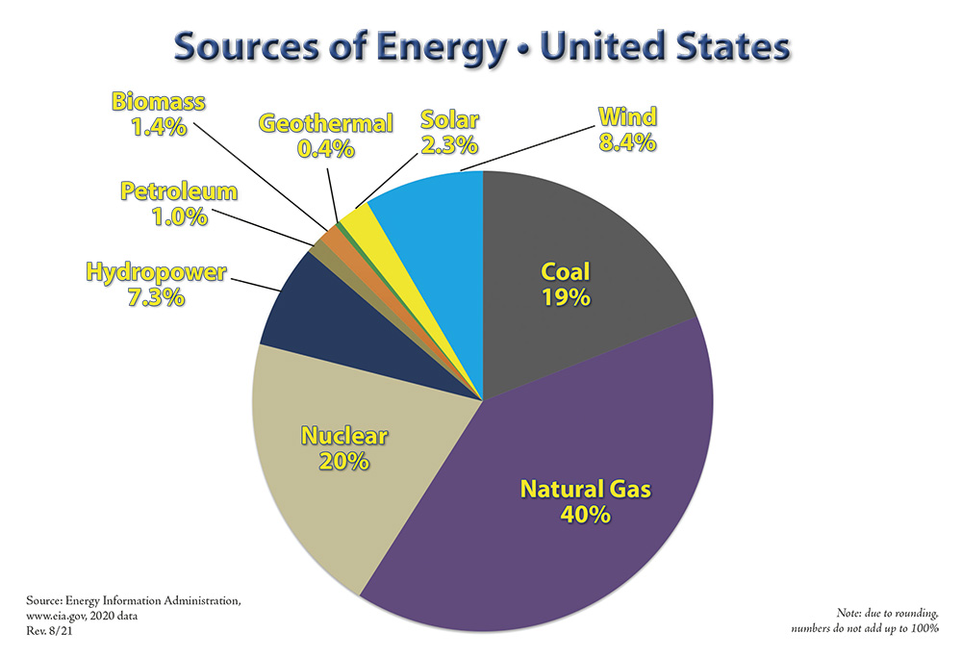
Notes:
What resources are most used across the United States to generate electricity?

Slide 8
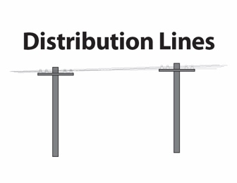
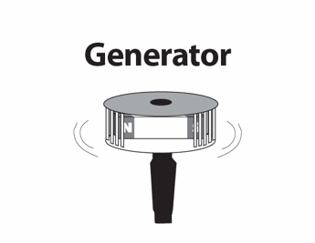
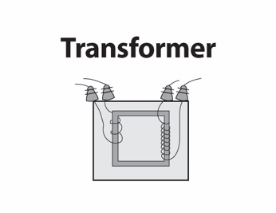
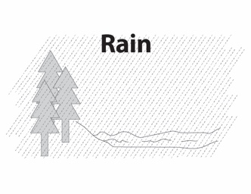
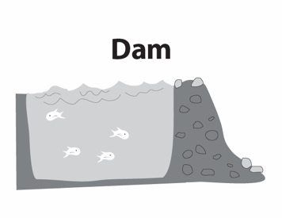
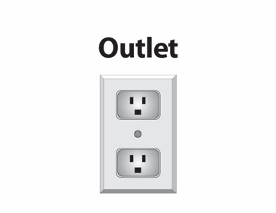
Cards
Put the cards for the Journey of Hydropower in order the best you can.
HINT: Use clues from the pictures to group cards that look like they go together.

Slide 9
Snow in the Mountains
Notes:
The journey of hydropower starts with snow falling in the Cascade mountains. When the snow melts it trickles into small mountain streams. The photo on the right is a PUD employee measuring snowpack. Knowing how much snowpack there is in the mountains helps us determine how much “fuel” we will have later in the year when snow begins to melt.

Slide 10
Rain
Notes:
Another way to make streams is by falling rain. Lots of rain falls in the Sultan Basin. This basin gets about 165 inches of rain per year making it one of the wettest watersheds in the US! When the rain hits the ground, it flows into little creeks or streams.

Slide 11
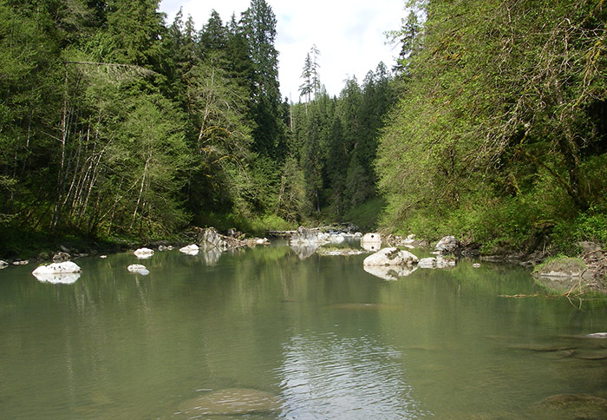
Sultan River
Notes:
All the creeks and streams eventually travel into rivers and the rivers flow into the ocean. Here is a picture of the Sultan River. The Sultan River collects all the melted snow from the mountain streams and all the rain that falls in the basin.
We can harness the energy of this moving water to generate electricity. Has anyone ever been to Sultan? If you’ve driven on Hwy 2 up to Steven’s Pass or Leavenworth, you’ve driven through the town of Sultan. (Show map so students can get an idea of where this system is located.)

Slide 12
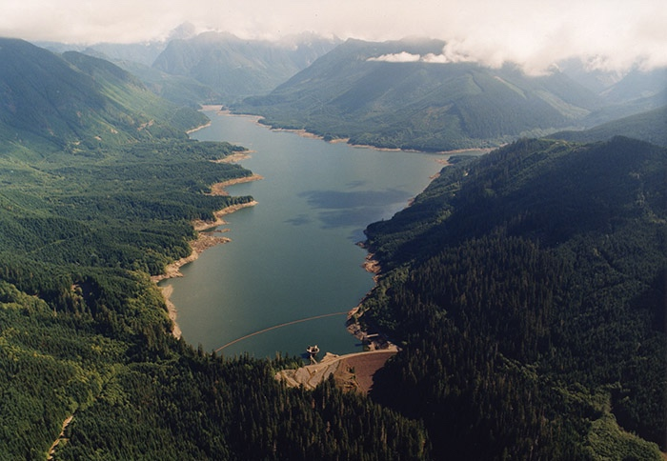
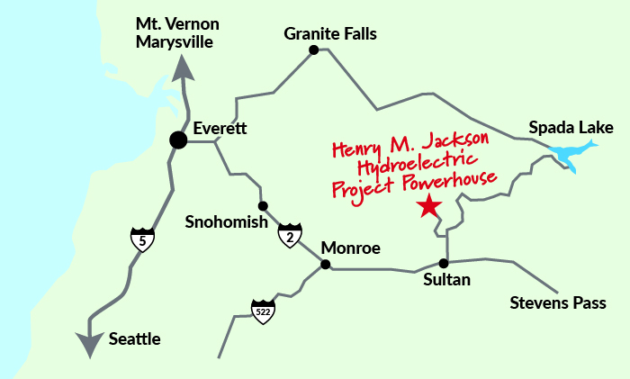
Spada Lake Reservoir
Notes:
A reservoir or lake forms behind a dam and stores the water for the power plant, and in this case, also provides drinking water for a lot of Snohomish County. This is the Spada Lake Reservoir created from the Culmback Dam. Can you find the dam in this photo?

Slide 13
Spada Lake Reservoir
Notes:
The yellow arrow is pointing to the Culmback Dam.

Slide 14
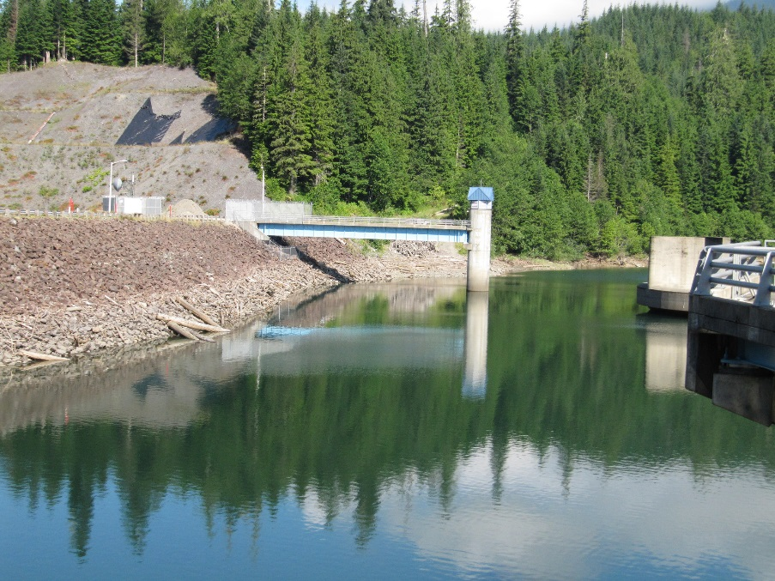
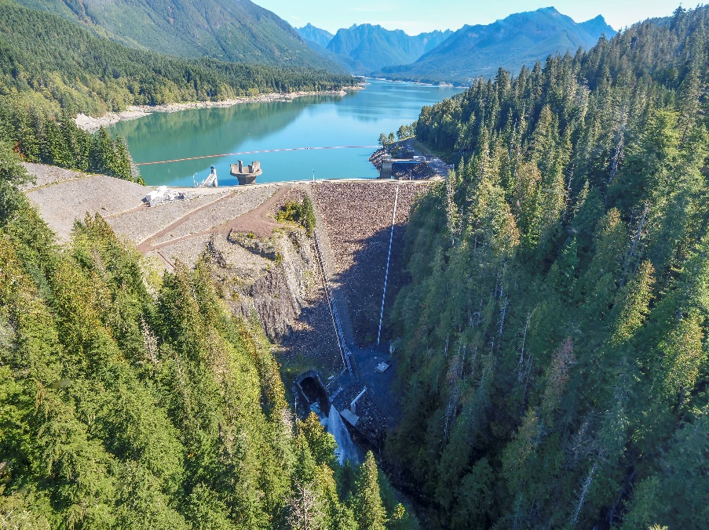
Culmback Dam
Notes:
The dam holds back the water. It is the barrier built across the Sultan River to control the flow of water. You are looking at pictures of the Culmback Dam in Sultan, WA.

Slide 15
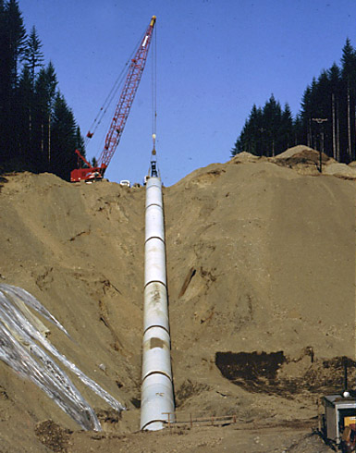
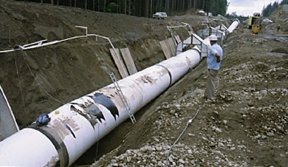
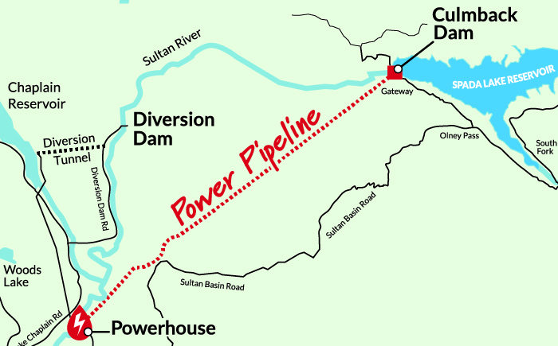
Penstock
Notes:
Next, the water moves from the reservoir to the power plant through a large underground pipe called a penstock. These photos show the penstock being constructed. The penstock makes it possible for the water to fall farther and steeper. The faster the water flows, the more energy it has.

Slide 16
The Jackson Penstock Diameter Demo
Notes:
Let’s do a demo to investigate exactly how big this penstock is. To measure the penstock, we’re going to measure its diameter. Does anyone know what diameter means? The diameter is the distance from one point on a circle through the center to another point on the circle.

Slide 17
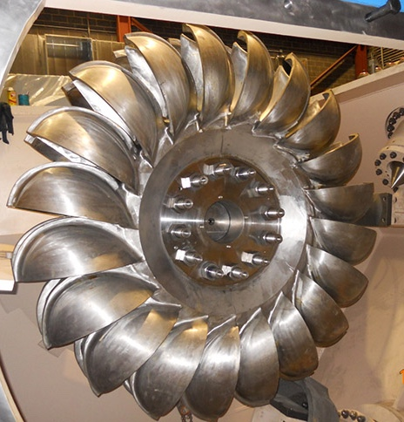
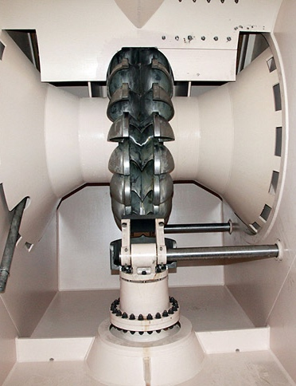
Turbine
Notes:
After the water travels through the penstock, it arrives at the power plant and is ready to turn the first machine called a turbine. The turbine has blades on one end and when the water comes out of the penstock the force of the water makes the blades spin. The turbine is attached to a shaft which also then spins.

Slide 18
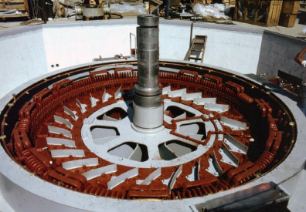
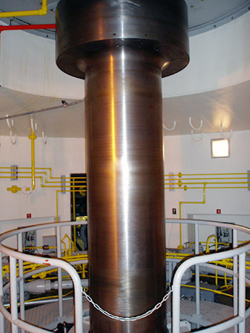
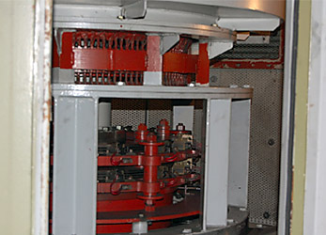
Shaft & Generator
The shaft is connected to the turbine.
The generator is made of coils of copper wire and strong magnets.
Notes:
The turbine and the shaft are attached to the generator so once the turbine spins, the generator also spins, TRANFERRING more of that motion energy. The generator has 2 parts: coils of copper wire and magnets. The spinning magnets cause the electrons in the wire to begin to move, generating electricity. This machine TRANFORMS or CONVERTS motion energy into electrical energy.

Slide 19
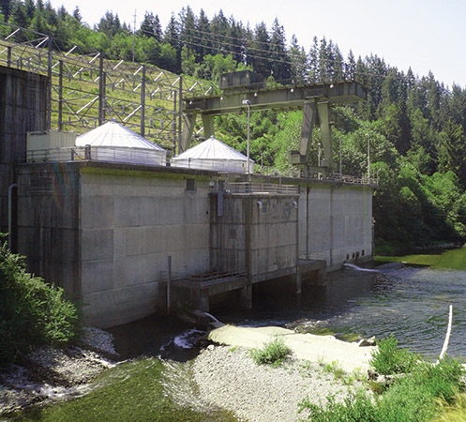
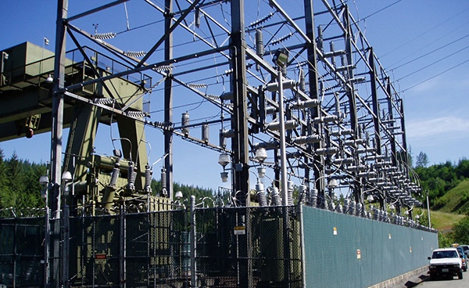
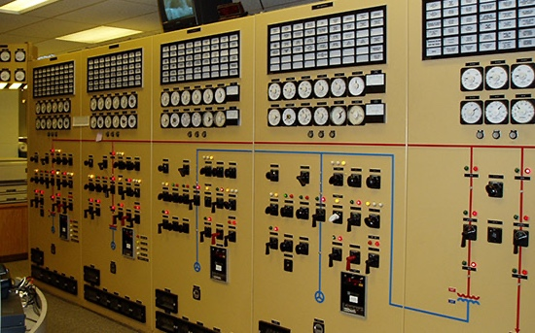
Transformer
Notes:
On the way out of the power plant the electricity is sent through large wires to a transformer that steps up, or increases, the voltage. This extra push makes it so the electricity can travel long distances to get it where it needs to go. What happens to the water? Some of it drops down from the turbine after it does its job, falls through grates on the floor, and flows back out to the river. The rest of the water goes through pipes and becomes drinking water. This journey has not changed the water at all!

Slide 20
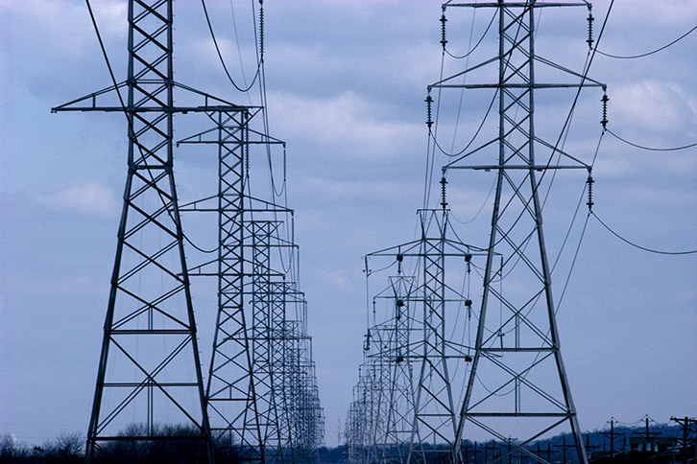
Transmission Lines
Notes:
The electricity travels over transmission lines. They are found along highways and are not typically in neighborhoods.

Slide 21
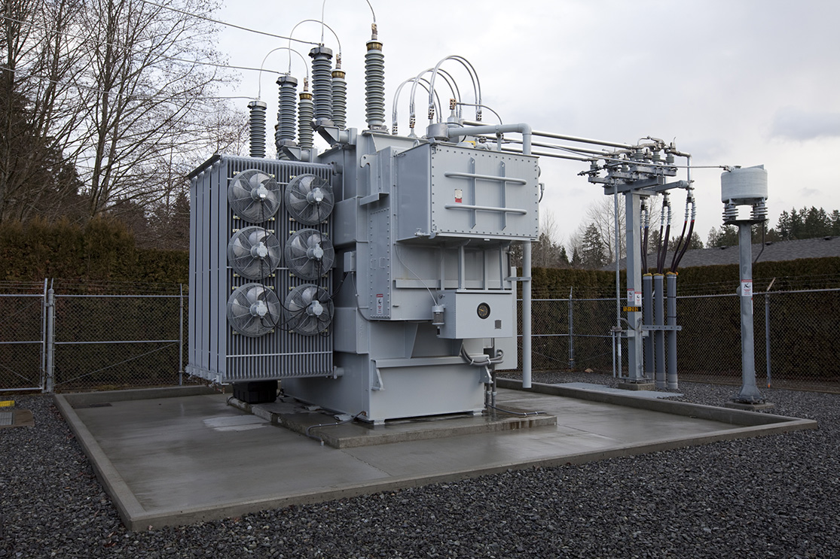
Substation
Notes:
Now it’s time to get the electricity to our neighborhoods. The electricity moves through substations where transformers step down, or decrease, the voltage. There are more than 100 of them in PUD’s service area!

Slide 22
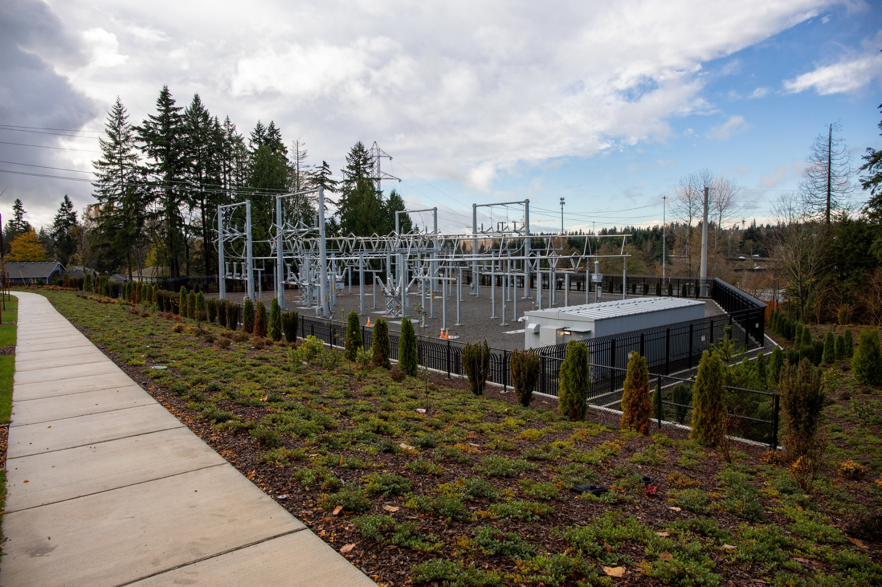
Notes:
Substations are extremely dangerous! They have a tall fence around them for a reason. Stay far away from them!

Slide 23
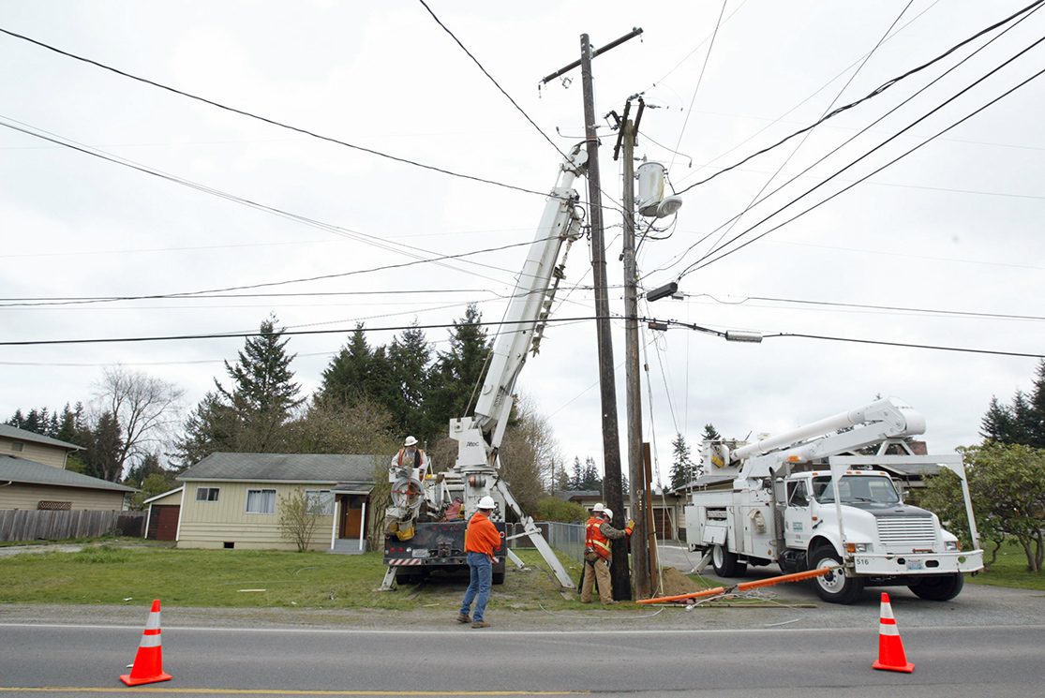
Distribution Lines
Notes:
Electricity then flows from the substation onto distribution lines. You can spot these wires running along highways and on neighborhood streets. Sometimes the wires are strung on wooden power poles and sometimes they are buried underground.

Slide 24
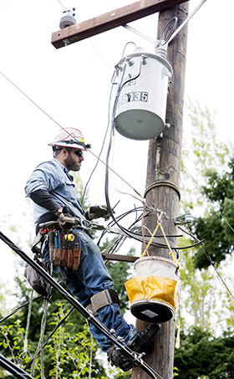
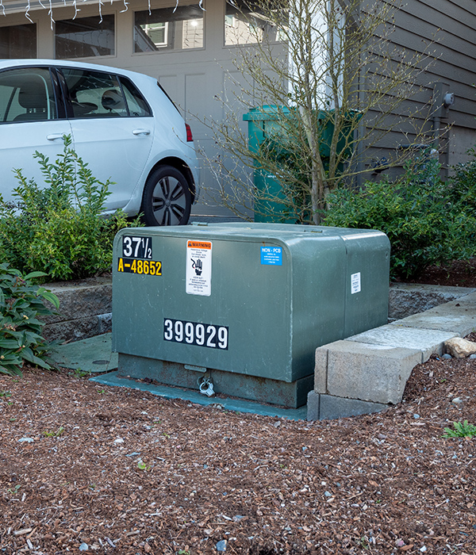
Pole or Padmount Transformers
Notes:
The voltage needs to be lowered one more time before it’s safe to enter your home. This happens at a polemount or padmount transformer. Padmount transformers are used when distribution lines are buried, and polemount transformers are used if lines are above ground.

Slide 25
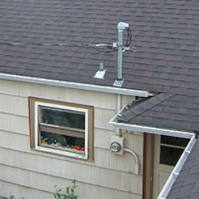
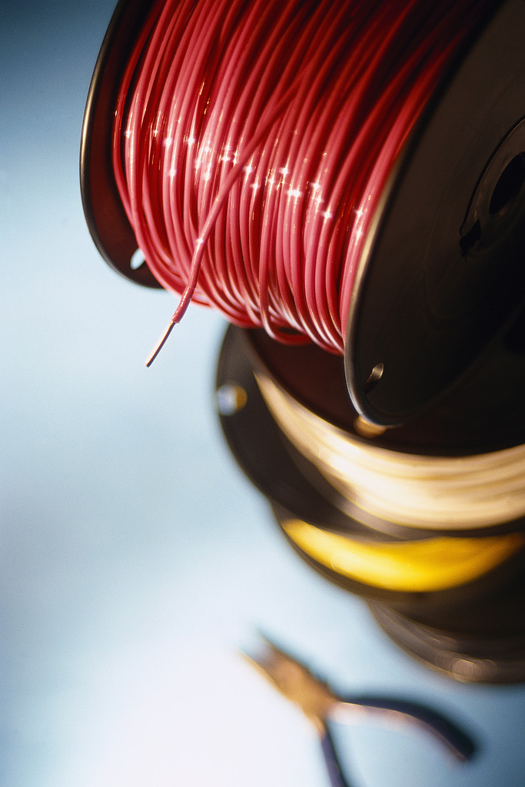
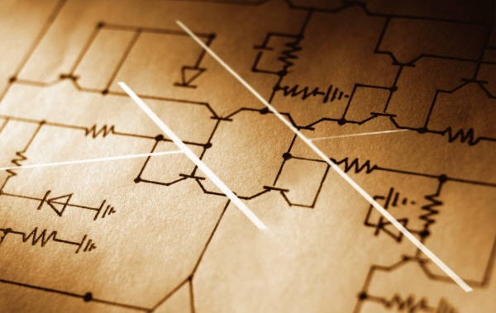
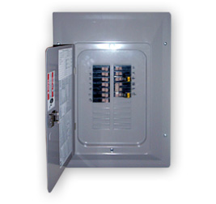
House Wires
Notes:
Once in your home, the electricity flows through house wires in the walls, floors, and ceiling.

Slide 26
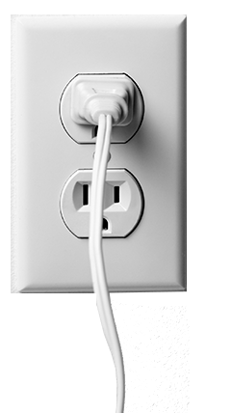
Outlet
Notes:
Those house wires are connected to outlets in the walls where we plug in appliances and electronic devices to be powered up.

Slide 27
Light
Notes:
Finally, you can turn on a lamp when it’s plugged in to an electrical outlet and immediately the bulb lights. Now some of that electrical energy is TRANSFOMED or CONVERTED to light energy.

Slide 28
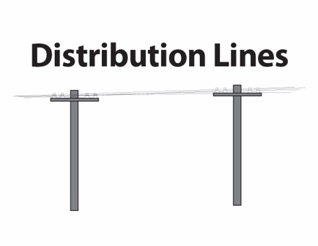
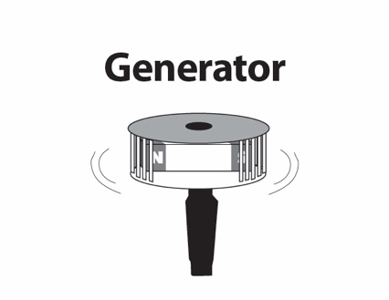
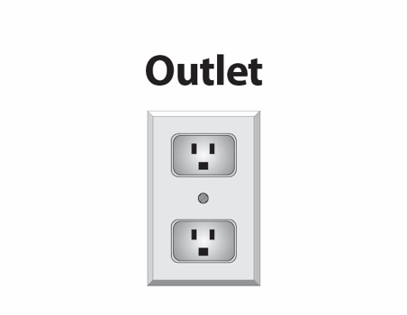
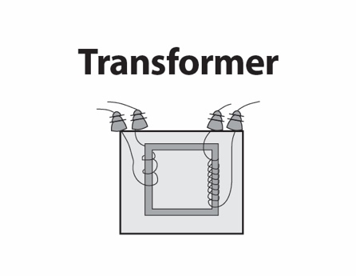
Cards
Reorder your cards now that you’ve learned the correct steps.

Slide 29
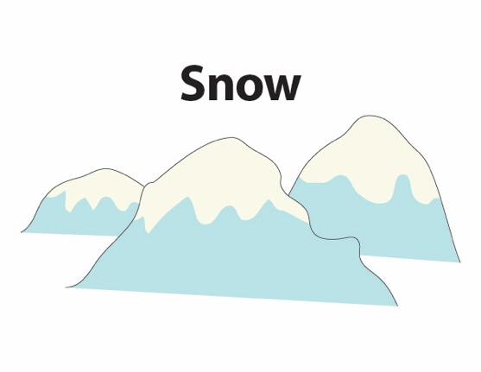
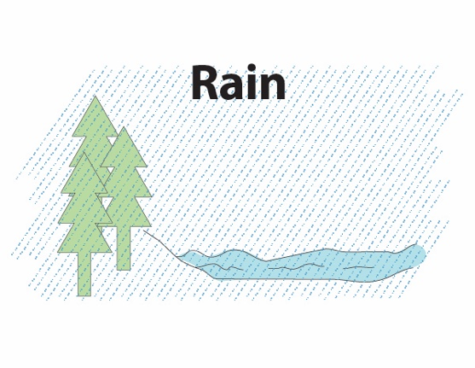
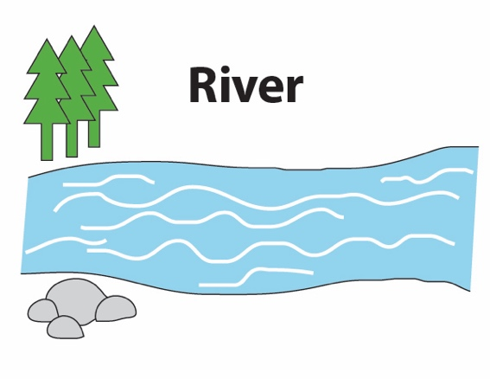

Slide 30
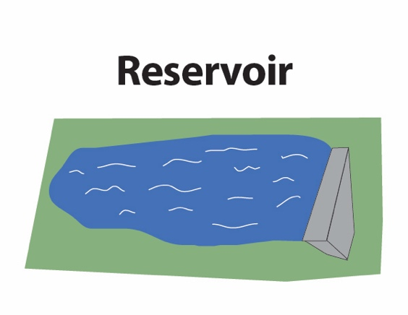
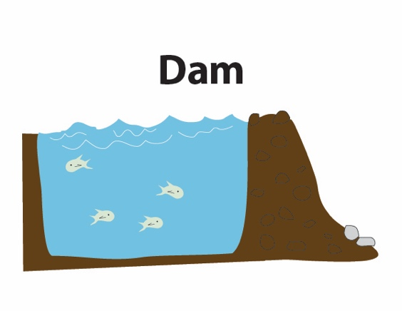

Slide 31
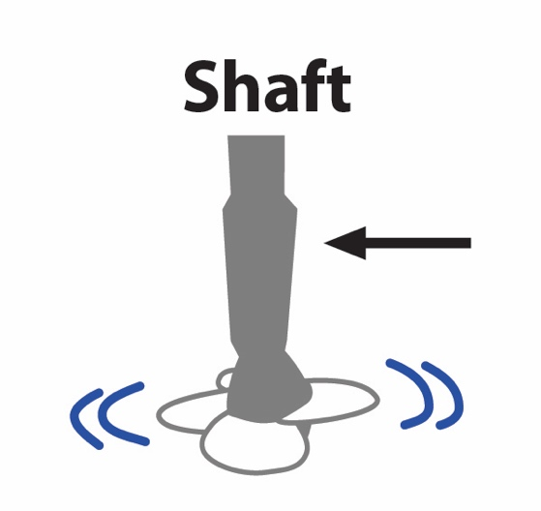
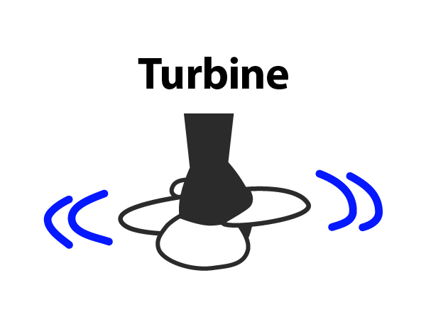
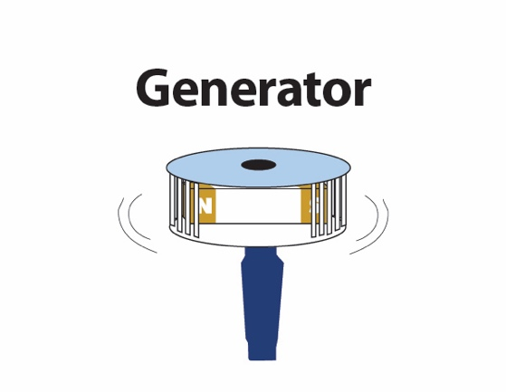

Slide 32
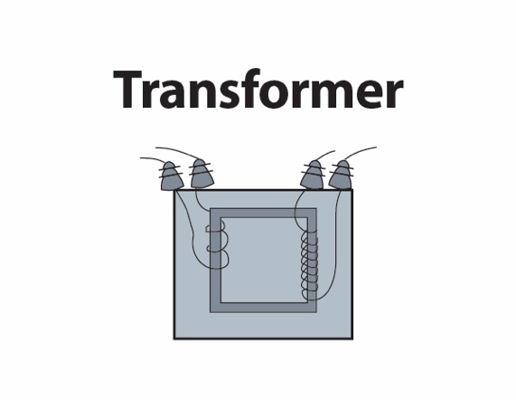

Slide 35
What is the name of the part in the system where motion energy is transformed into electrical energy?
A GENERATOR transforms motion energy into electrical energy.

Slide 36
Careers in Hydropower
Power Scheduler – Civil Engineer – Fish Biologist – Environmental Scientist – Hydrologist – Lineworker – Mechanic – Welder – Drill Operator – Attorney – Park Ranger – Compliance Coordinator – Maintenance Machinist – Construction Worker – Equipment Operator – Power Systems Engineer – Power Plant Operator – Terrestrial Biologist…

Slide 37
Next time you plug something in…

