Slide 1


Jackson Project, Dam Safety & EAP Update – Online Training 2025
Narrated By: Scott Spahr, PE
Manager Generation Engineering

Slide 2
Overview
How the Project Works
How Culmback Dam was built
How we make sure it is safe
What we would do if something went wrong

Slide 3
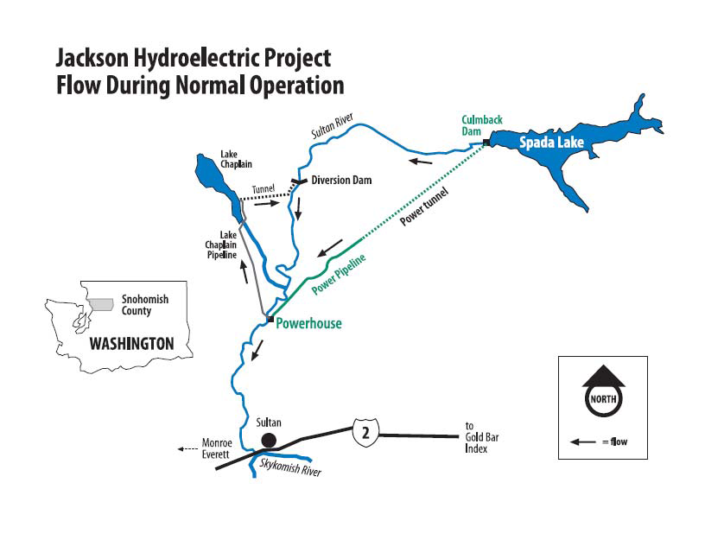

JACKSON PROJECT – OVERVIEW
Notes:
Map of the Project Area - Orientation to the landscape
Area of active fish management: Lower 16 miles of the Sultan River, the upstream boundary being defined by a natural barrier and the downstream boundary being the Skykomish River
Notable Feature: Diversion Dam, barrier to upstream migration, installed at RM 10
No storage impoundment in headwaters

Slide 4
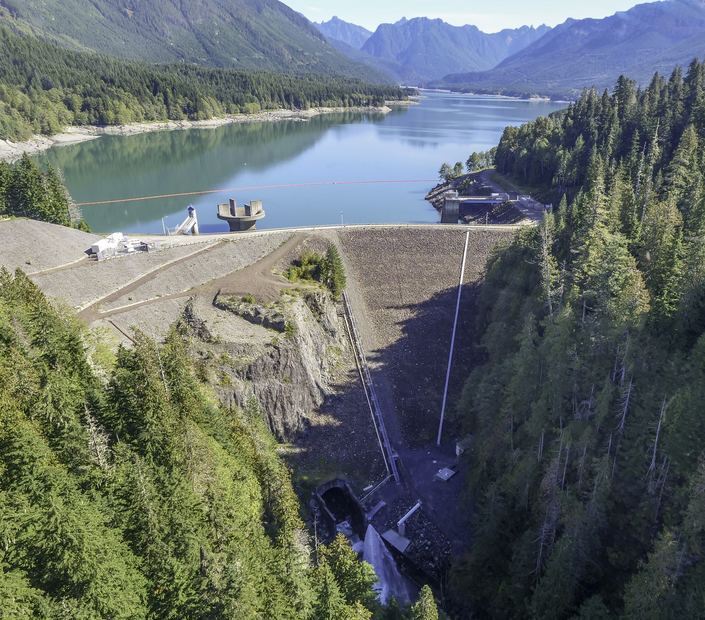
Spada Lake and Culmback Dam
Earth fill - clay core
  262 ft high
  640 ft across
Stage I completed in 1964, Stage II completed in 1984
  55-years of operation

Slide 5
Stage I – Culmback Dam
Filled a very narrow bedrock canyon

Slide 6
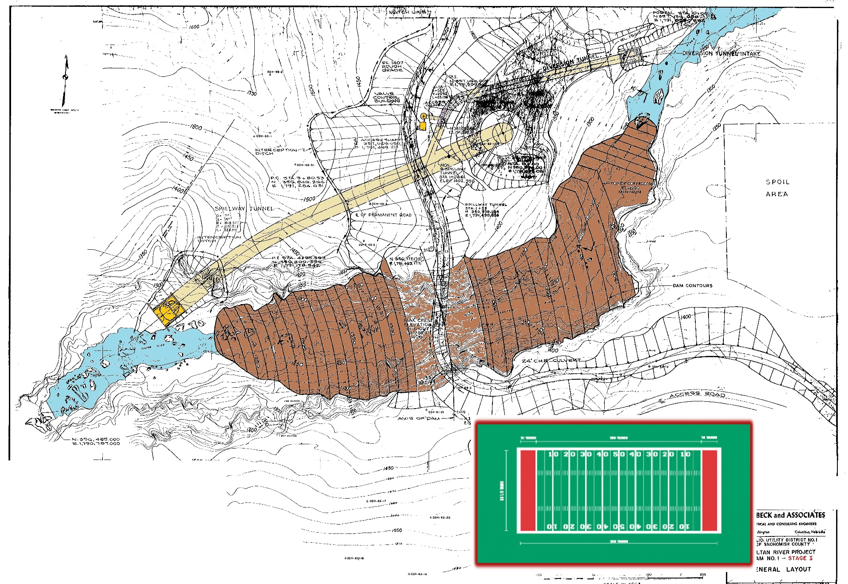
Stage I – About 3 football fields long

Slide 7
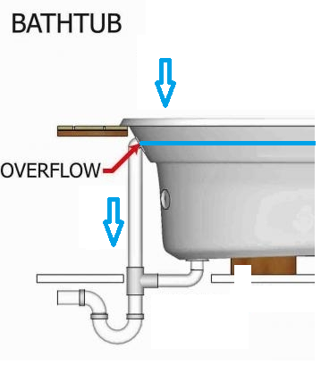
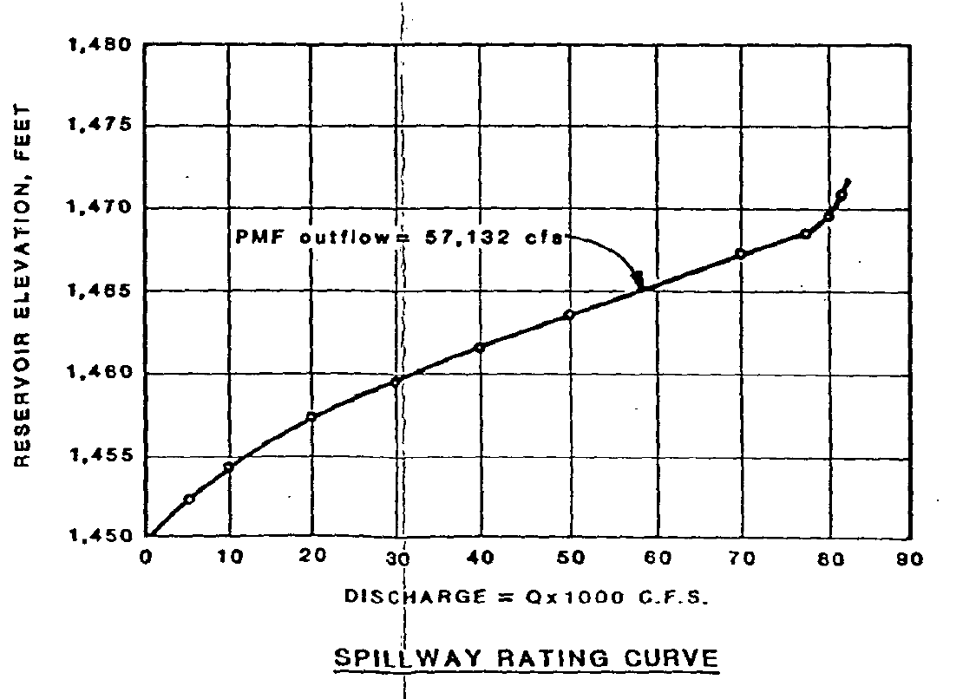
Morning Glory
Spillway
20’ – Freeboard
Capacity of spillway before dam overtops: 80,000-cfs
PMF: Predicted largest flood basin may experience 57,100-cfs
Largest spill 17,000-cfs (Nov 1990)

Slide 8
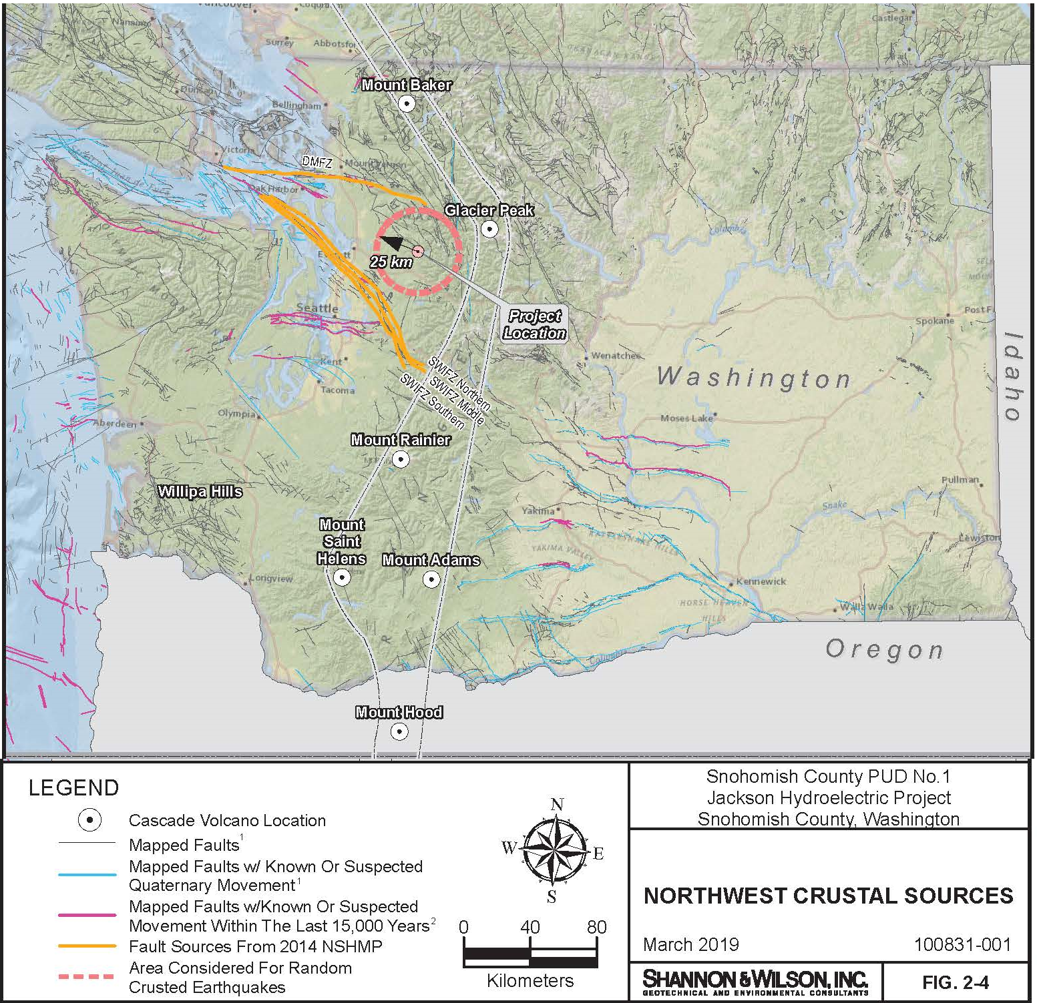
Maximum Credible Earthquake
  Based on local crustal faults (~13 km, ~7.5 Richter) **Cascadia has less impact
  Culmback Stability re-evaluated in 2010
  Morning Glory Stability re-evaluated in 2018-19

Slide 9
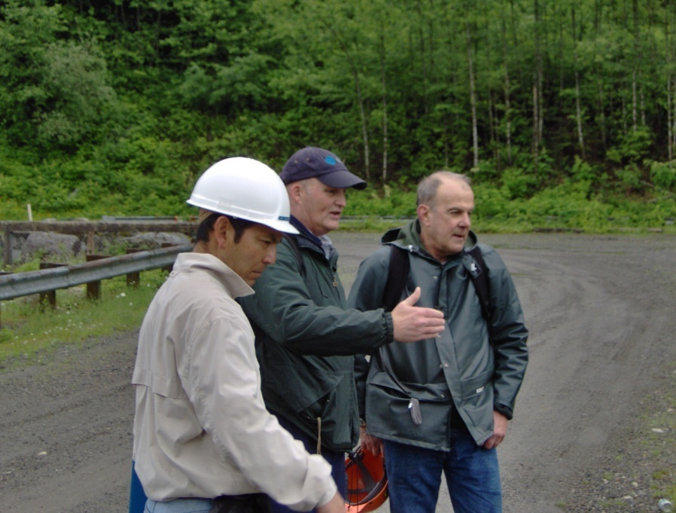
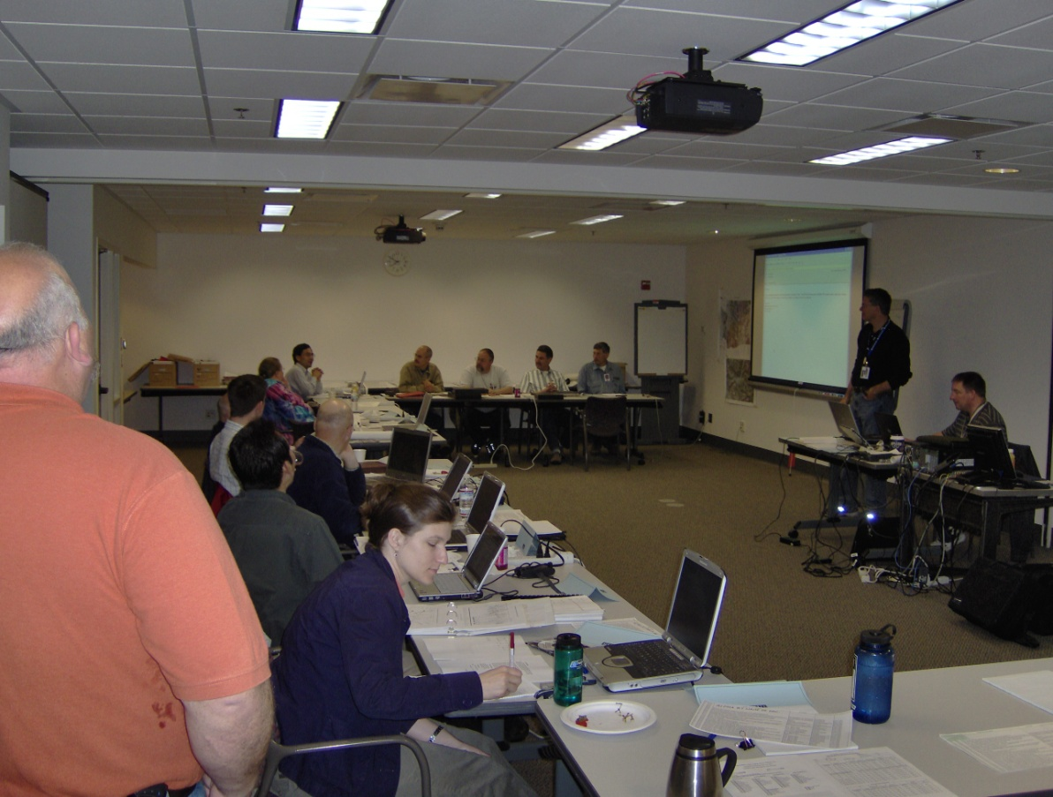
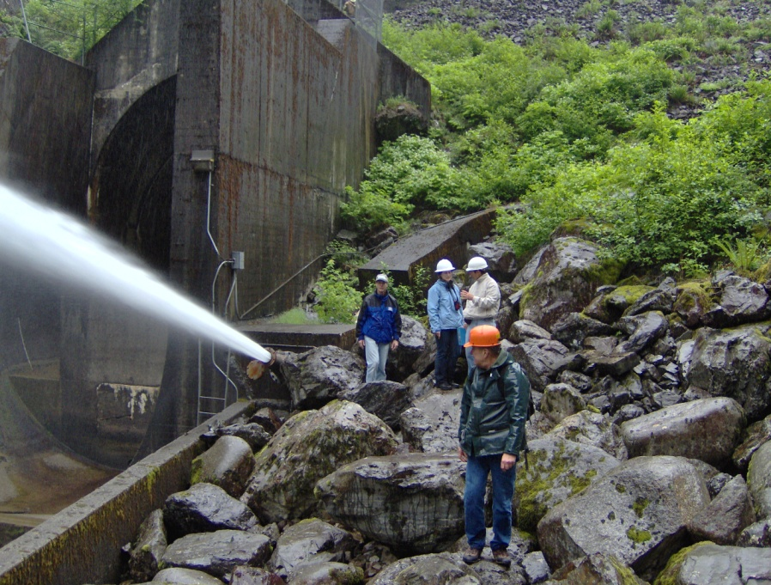
Project Inspections
* Real-time alarm monitoring and cameras 24x7
* Daily/Monthly Inspections by staff
* FERC Staff (annually)
* Independent Consultants (5 years)

Slide 10
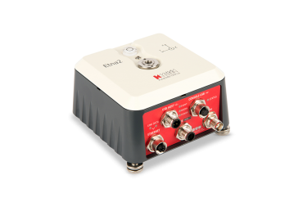
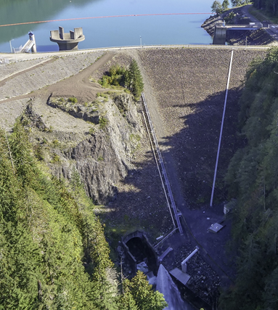
Culmback Dam
EAP/SMP Features
  Lake Level Changes
  Rainfall Gauge
  Seismic Sensors
  Piezometers
  Toe Alarm
  Stream Gage
Alarm sent, read following earthquake felt by staff

Slide 11
What happens if the dam fails?
The animation on the next slide shows the spread of water, and depths associated with a sudden dam failure. It represents a ‘sunny day’ failure.
This animation and the times associated assume a complete loss of the dam structure virtually instantaneously. This is virtually impossible.
However, this is a tool to see how destructive the event would be and reinforces that any warnings should be followed up on immediately.

Slide 12
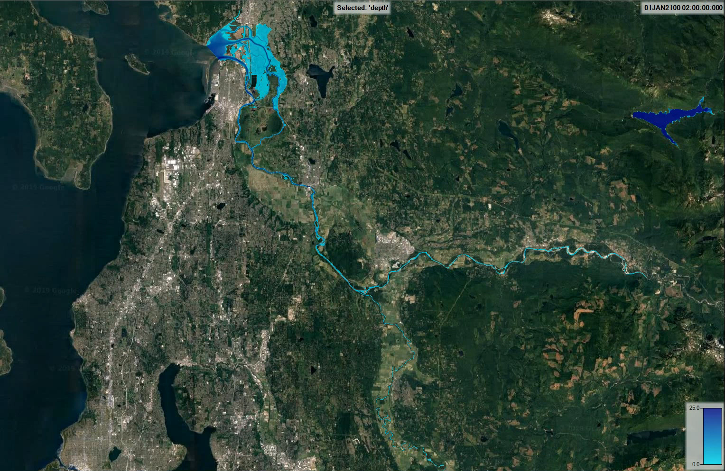
Culmback Dam
Snohomish
Leading edge reaches
Sultan in 1hr 36min
Everett
Leading edge reaches
Monroe in 2hr 48min
City of Duvall is outside of floodwaters,
But Snoqualmie Valley floods
This animation shows the predicted effect of a sudden failure of Culmback Dam with the downstream area in a fair weather condition

Slide 13
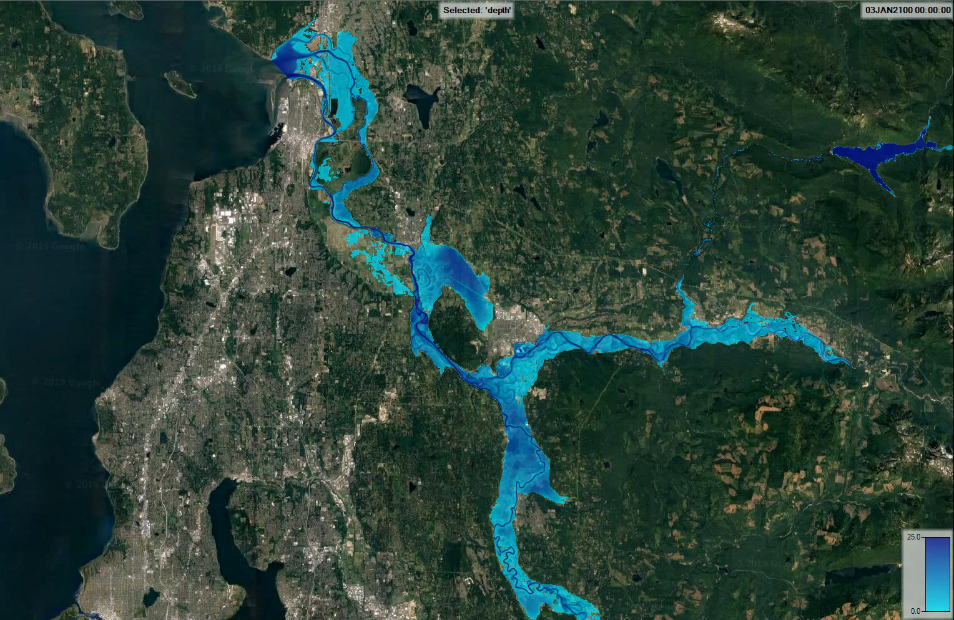
Leading edge reaches
Sultan in 1hr 24min
Leading edge reaches
Monroe in 2hr 21min
This animation shows the predicted effect of a sudden failure of Culmback Dam with the downstream area already in a 100-year flood condition

Slide 14
How do we alert people of issues?
The call-outs which follow indicate who is contacted if there is an issue at Culmback Dam.
All of the calls initiate with an observer contacting the on-call operator (after hours) or the powerhouse (work hours).

Slide 15
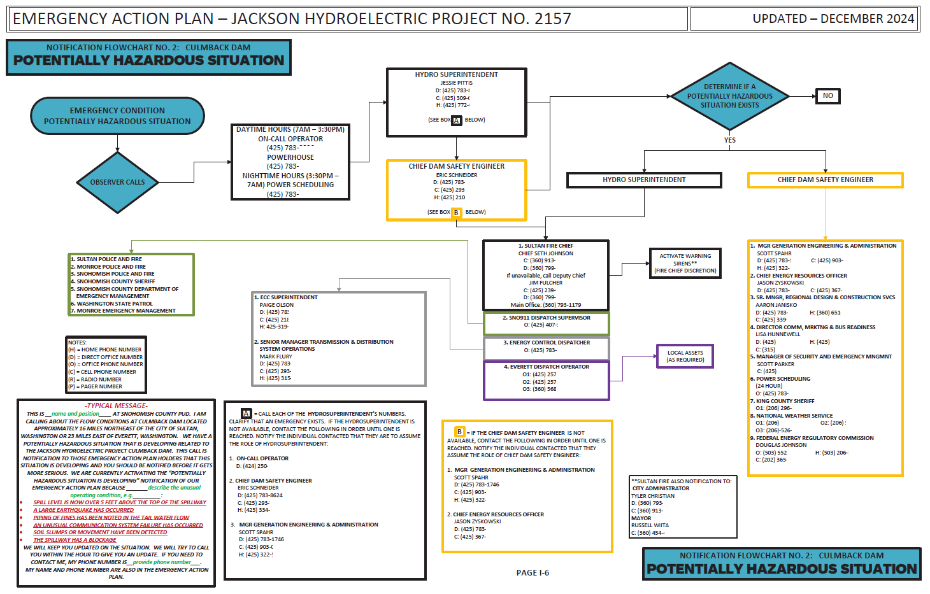
If a morning glory spill is about to occur

Slide 16
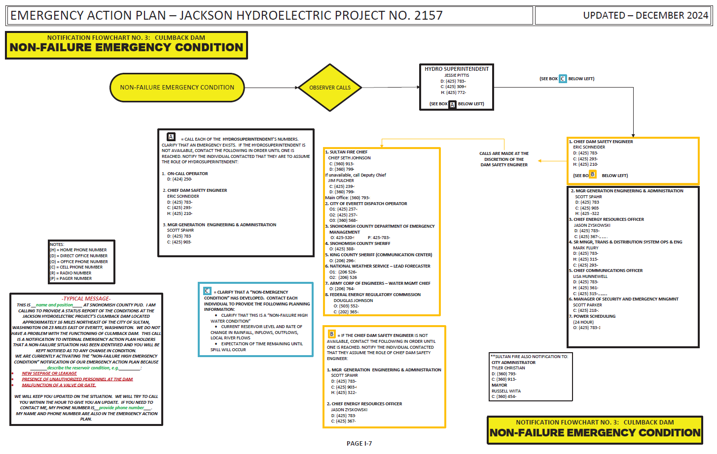
large earthquakes in Snohomish County
abnormal reservoir high water levels - unusual spill condition
spillway blockage
piping, soil boils, or slumps in the downstream face of Culmback Dam
movement or settlement of the dam
communication system failure
human threats

Slide 17
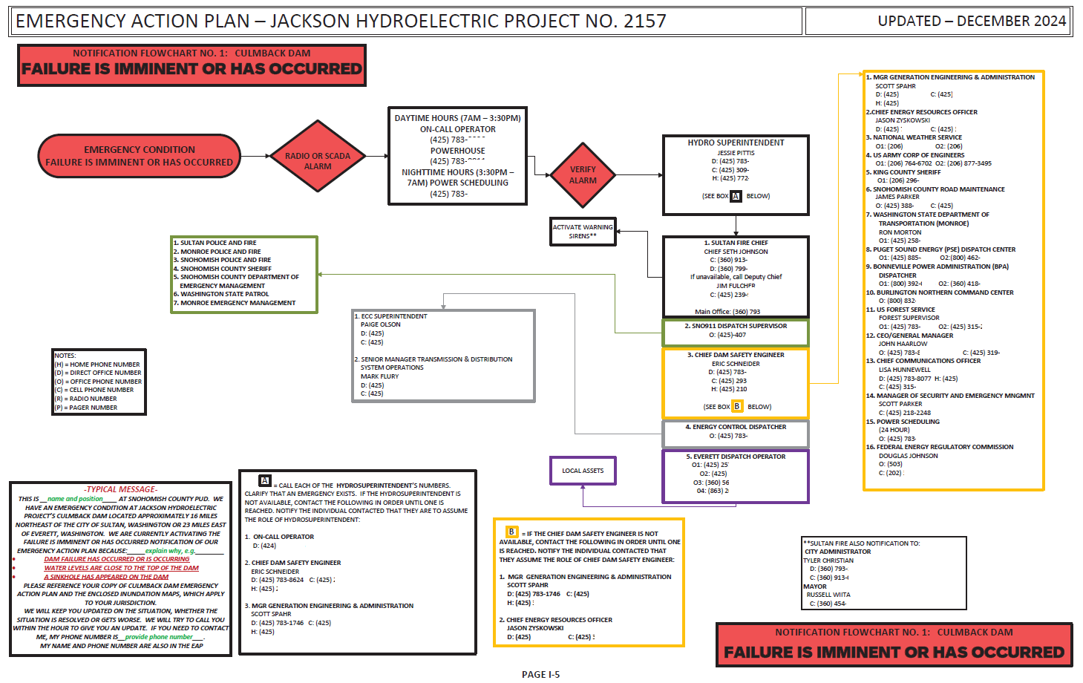
Failure is imminent or has occurred.

Slide 18
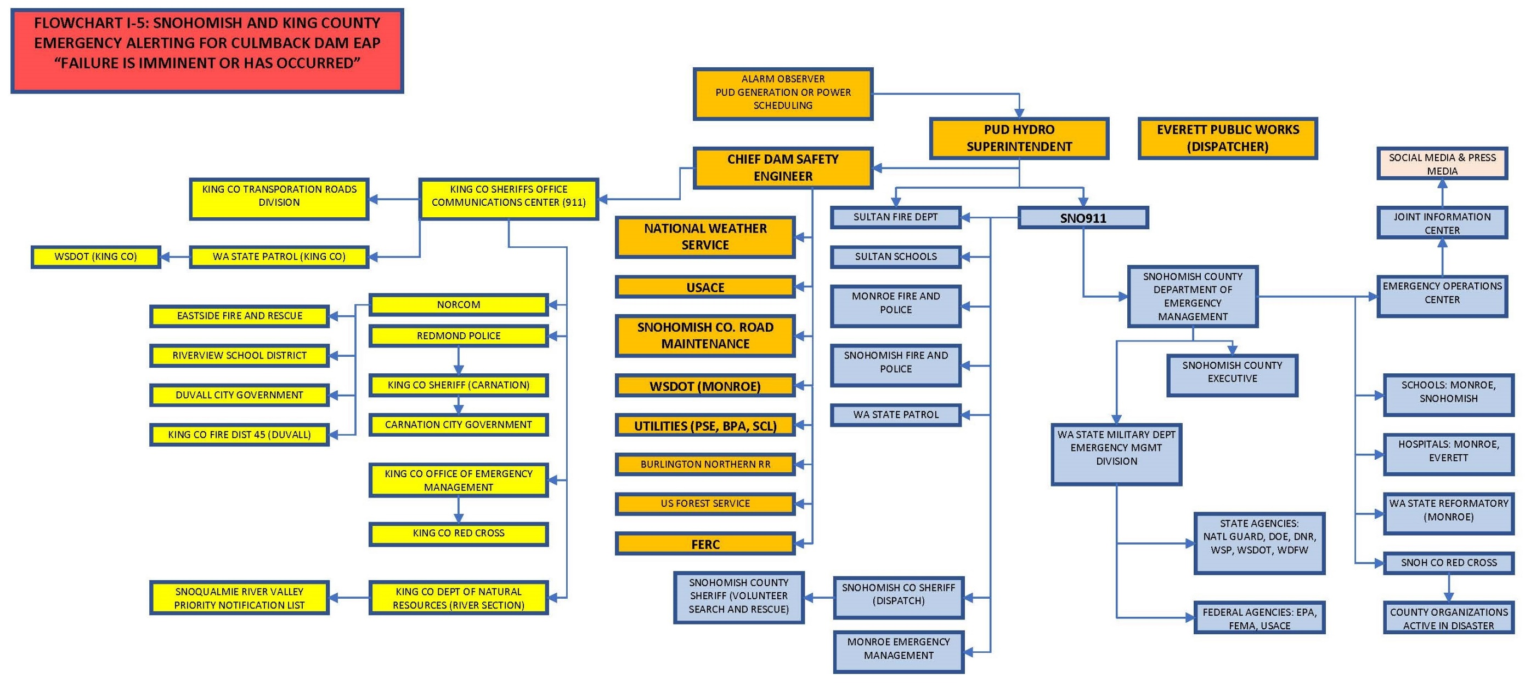
Communication beyond the PUD

Slide 19
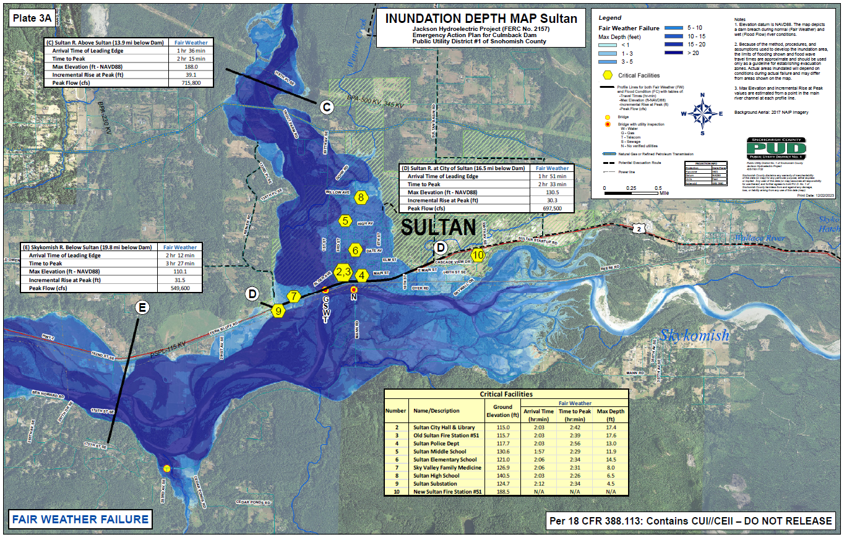
Inundation Map Update
The inundation maps were recently updated as the result of recent feedback from stakeholders at the 2022 Functional Exercise.

Slide 20
Summary
Culmback Dam provides essential public services (water and electricity) to Snohomish County.
The dam is well-built, maintained and monitored.
Because of the consequence of failure, it is important to know what to do in an emergency. Quick action is key, and it is better to over-communicate.
What we need from you: Please review that you have a current copy of the Culmback Dam Emergency Action Plan. Make sure it has accurate contact information for your agency, and that anyone who would be responding to an emergency has reviewed.

Slide 21
Questions and Feedback
We would welcome any questions or feedback:
  Eric Schneider
  (425) 293-7218
  easchneider@snopud.com
  or
  Scott Spahr
  (425) 903-0203
  sdspahr@snopud.com
  ** Particularly let us know about inaccurate contact information, or a lack of EAP copies.

